Slide 1
Training a Neural Network with Backpropagation
Using Python

Slide 2
What is a Neural Network?
• A neural network is a computational model inspired by the human brain.
• It consists of layers of interconnected neurons.
• Each neuron applies a weighted sum followed by an activation function.
• Networks learn by adjusting weights using training data.

Slide 3
Forward Propagation
• Input is passed through the network layer by layer.
• Each layer applies linear transformation + activation.
• Produces output prediction.
Equation: a = f(Wx + b)

Slide 4
Loss Function
• Measures the difference between prediction and target.
• Common choices: Mean Squared Error (MSE), Cross-Entropy Loss.
• Guides the training process.

Slide 5
Backpropagation Algorithm
• Computes gradient of loss function w.r.t. weights.
• Uses chain rule of calculus.
• Updates weights via Gradient Descent:
W = W - η * dL/dW
• Efficiently propagates error backward through network.

Slide 6
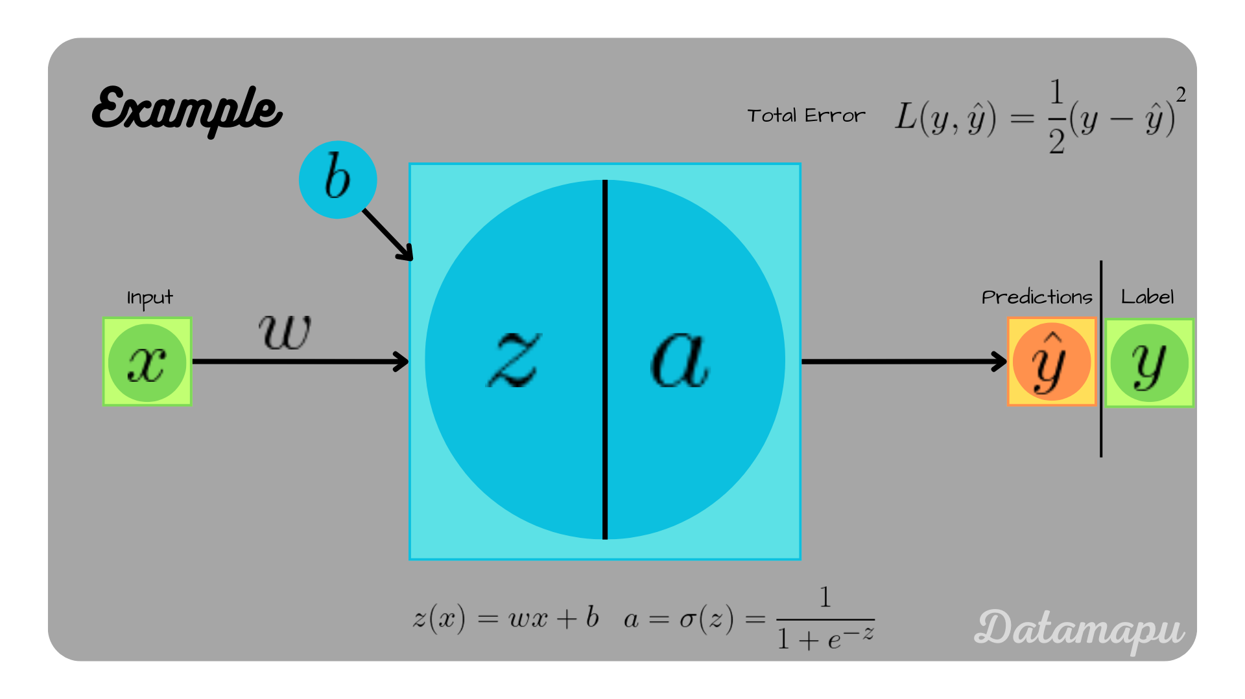
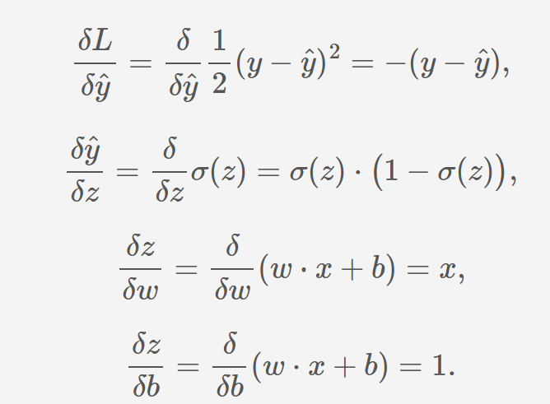
https://datamapu.com/posts/deep_learning/backpropagation/

Slide 7
Python Implementation
import numpy as np
# Activation function
def sigmoid(x): return 1/(1+np.exp(-x))
def sigmoid_deriv(x): return x*(1-x)
# Forward + Backward
for epoch in range(1000):
# forward
z = np.dot(X, W) + b
a = sigmoid(z)
# loss gradient
dz = (a - y) * sigmoid_deriv(a)
dW = np.dot(X.T, dz)
db = np.sum(dz)
# update
W -= lr * dW
b -= lr * db

Slide 8
Common issues during backpropagation

Slide 9
1-The vanishing gradient problem
Gradients are backpropagated through a network's layers, they are repeatedly multiplied by the derivatives of activation functions.
Sigmoid and Tanh derivatives are between 0 and 1➔repeated multiplication causes the gradients to shrink exponentially, eventually becoming near-zero.
This is the Vanishing Gradient: The weights in the earlier layers of the network receive negligible updates, causing them to learn very slowly or not at all

Slide 10
Solutions for vanishing gradients
Use Activation functions like ReLU have a derivative of 1 for positive inputs, which prevents gradients from shrinking : (Leaky ReLU, Parametric ReLU (PReLU) assign a small, non-zero gradient to negative inputs.)
Use proper weight initialization: e.g: set the initial weights based on the number of neurons in the layer.
Use residual connections: Architectures like ResNet use "skip connections" that allow gradients to bypass certain layers(dropout)
Apply batch normalization: This technique normalizes the input to each layer, which stabilizes the learning process and allows for higher learning rates.

Slide 11
2-The exploding gradient problem
Large gradients accumulate during backpropagation, causing the network's weights to increase exponentially➔ unstable network that fails to converge or produces NaN (Not a Number) values.

Slide 12
Solutions for exploding gradients
Gradient clipping: Set a threshold for gradients. If a gradient's value exceeds this threshold, it is scaled down.
Weight regularization: Techniques like L1 or L2 regularization add a penalty to the loss function based on the size of the weights.
Redesign network architecture: For recurrent neural networks (RNNs), using Long Short-Term Memory (LSTM) units or other gated architectures can help control the flow of gradients and prevent them from exploding.

Slide 13
3-The dead ReLU problem
Dead ReLU neurons occur when the weighted sum of inputs to a ReLU activation is consistently negative➔since the derivative of ReLU is 0 for negative inputs, these neurons stop contributing to the network's output and cease learning altogether.
➔A significant portion of the network can become inactive, limiting its learning capacity.

Slide 14
Solutions for dead ReLUs
Use ReLU variants: Leaky ReLU and PReLU avoid this problem by allowing a small, non-zero gradient for negative inputs.
Lower the learning rate: A very high learning rate can push neurons into this inactive state. Reducing it can help stabilize the training.
Use batch normalization: By normalizing layer inputs, batch normalization reduces the likelihood that a neuron's activation will fall into the "dead" region.

Slide 15
4-Suboptimal learning rate
A learning rate that is too high can cause the model to overshoot the optimal solution, while a learning rate that is too low can result in slow convergence.
High learning rates lead to training instability; low learning rates make training inefficient

Slide 16
Solutions for learning rate issues
Use adaptive optimizers: Optimizers like Adam, RMSprop, or AdaGrad automatically adjust the learning rate during training, allowing for faster and more stable convergence.
Use learning rate schedulers: These functions dynamically change the learning rate over time based on a predefined schedule or the model's performance on a validation set.

Slide 17
5-Overfitting and underfitting
Overfitting: The model learns the training data and its noise too well, causing it to fail on unseen data.
Underfitting: The model is too simple to capture the underlying patterns in the data, resulting in poor performance on both training and test data.

Slide 18
Solutions for overfitting
First two are very popular
Regularization: Use L1/L2 penalties to constrain weight values and simplify the model.
Dropout: Randomly drop out neurons during training to prevent the network from becoming over-reliant on specific connections.
Data augmentation: Increase the size and diversity of the training data.
Early stopping: Halt training when the validation loss stops improving to prevent the model from memorizing noise.

Slide 19
Solutions for underfitting
Increase model capacity: Add more layers or neurons to allow the model to learn more complex patterns.
Increase training time: Run more epochs to give the model more time to learn.
Adjust features: Add more relevant features or perform feature engineering.
One Hot Encoding (more features)

Slide 20
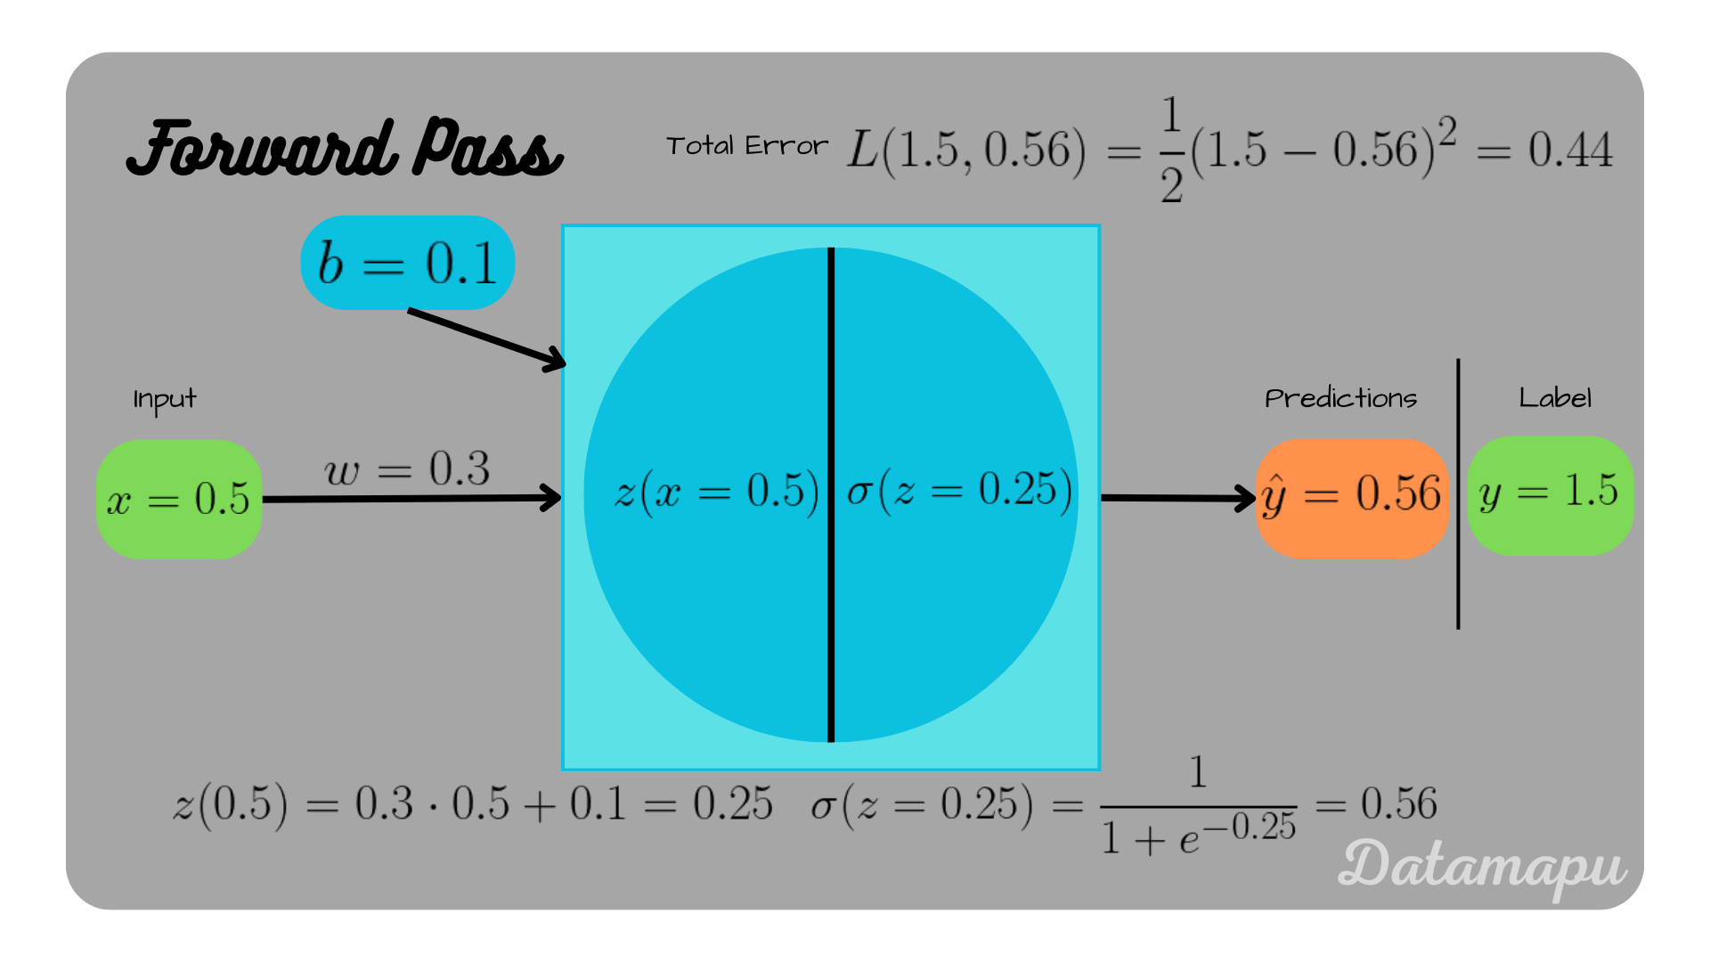

Slide 21
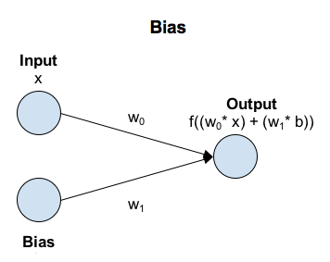
Numeric Example: Training with Backpropagation
Setup
Input: x = [1, 0]
Weights: W = [0.5, -0.5], Bias = 0.0
Target: y = 1
Step 1: Forward
z = (1×0.5 + 0×-0.5) + 0 = 0.5
a = sigmoid(0.5) ≈ 0.62
Loss = (y - a)² ≈ (1 - 0.62)² = 0.144

Slide 22
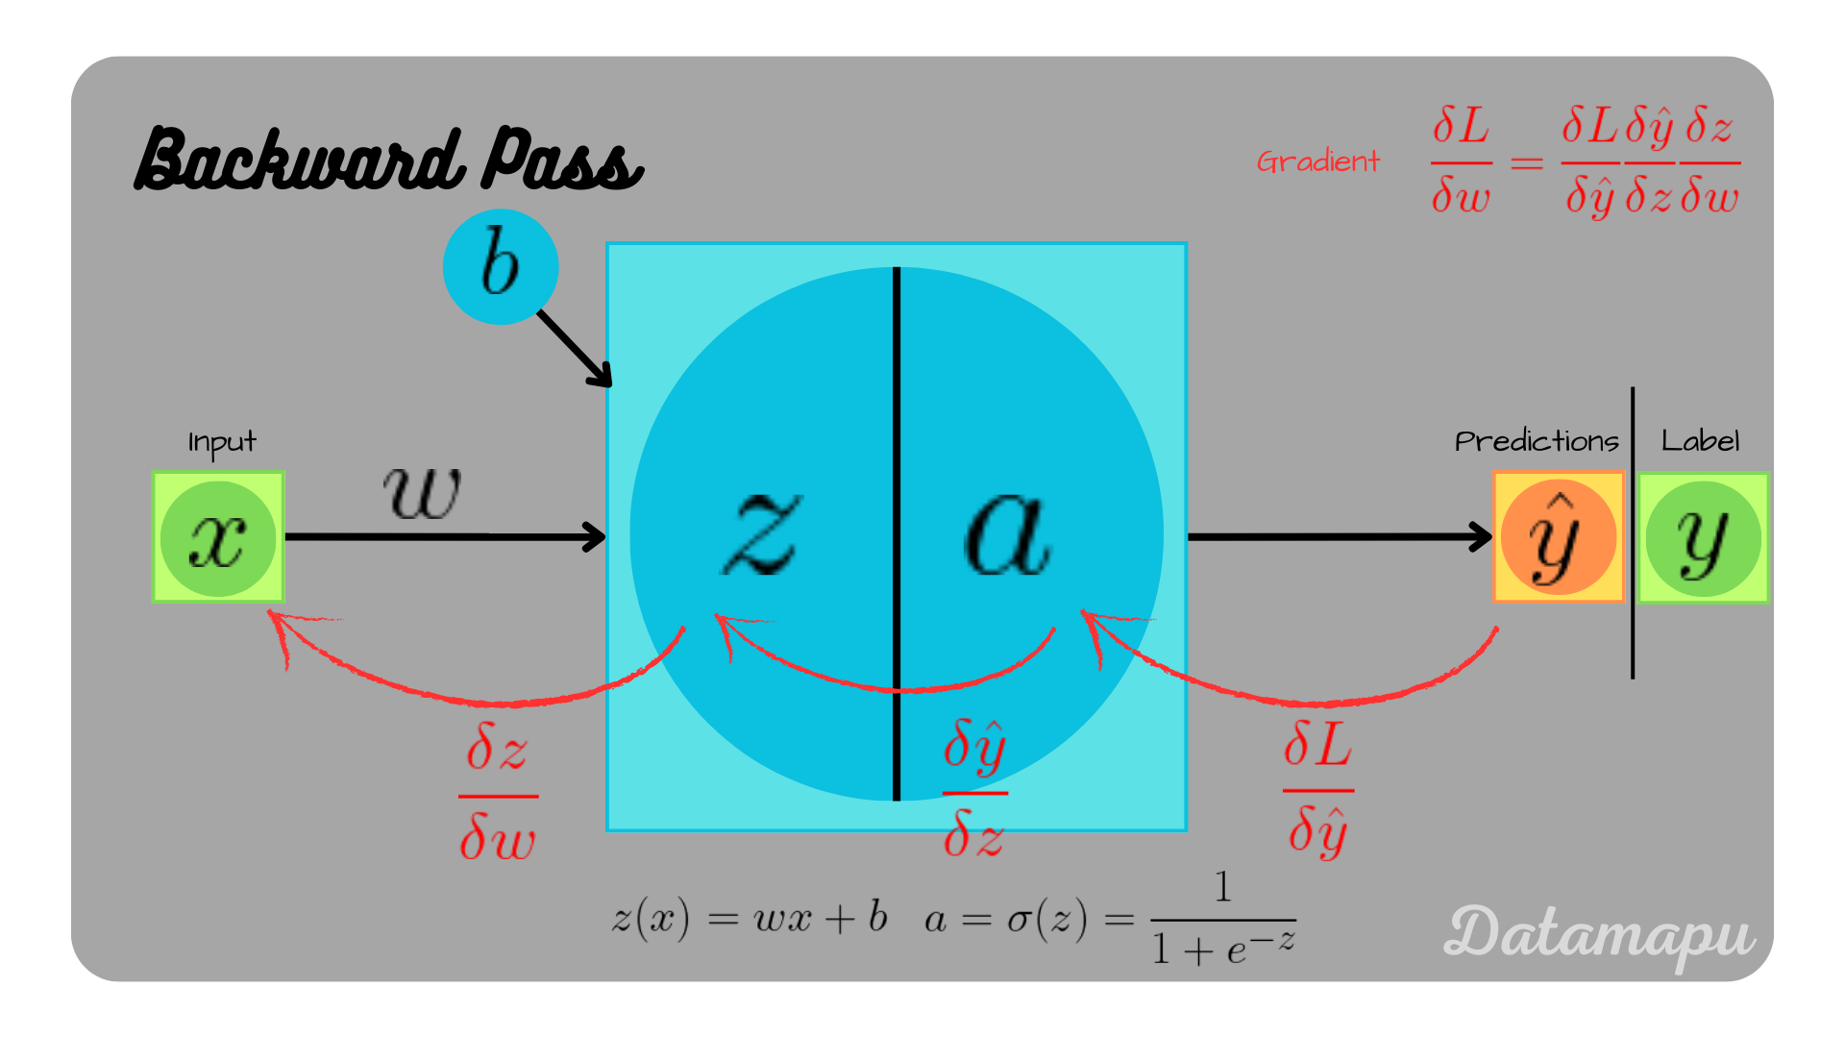

Slide 23
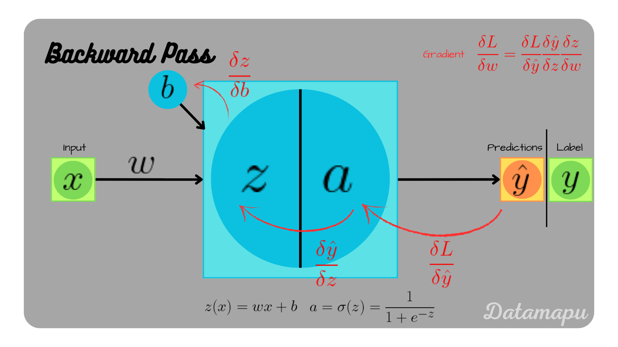

Slide 24
Numeric Example: Training with Backpropagation
Step 2: Backward
dL/da = -2×(y - a) = -0.76
da/dz = a(1 - a) = 0.235
dL/dz = dL/da × da/dz = -0.178
dL/dW1 = x1 × dL/dz = 1×-0.178 = -0.178
dL/dW2 = x2 × dL/dz = 0×-0.178 = 0
dL/db = dL/dz = -0.178

Slide 25
Numeric Example: Training with Backpropagation
Step 3: Update (lr = 0.1)
W1 = 0.5 - 0.1×(-0.178) ≈ 0.518
W2 = -0.5 - 0.1×0 = -0.5
b = 0 - 0.1×(-0.178) ≈ 0.018
+++

Slide 26
Updated Prediction After One Step
Step 4: Forward Pass with Updated Weights
Updated weights: W = [0.518, -0.5], b = 0.018
Input: x = [1, 0]
z = (1×0.518 + 0×-0.5) + 0.018 = 0.536
a = sigmoid(0.536) ≈ 0.631

Slide 27
Loss
Step 5: Loss After Update
Target: y = 1
Loss = (y - a)² ≈ (1 - 0.631)² = 0.136
Loss decreased from 0.144 → 0.136 after one backpropagation step
The neuron is learning and moving closer to the target

Slide 28
Training Progress Over Iterations(in class)
GIVEN Iteration 1 (already covered-start of iteration 2)
W = [0.5, -0.5], b = 0.0
Forward: z = 0.5 → a ≈ 0.62
Loss ≈ 0.144
Backpropagation updates: W = [0.518, -0.5], b ≈ 0.018
Updated loss ≈ 0.136

Slide 29
How backpropagation and gradient descent optimize weights iteratively Iteration 2,3,4,5

Slide 30
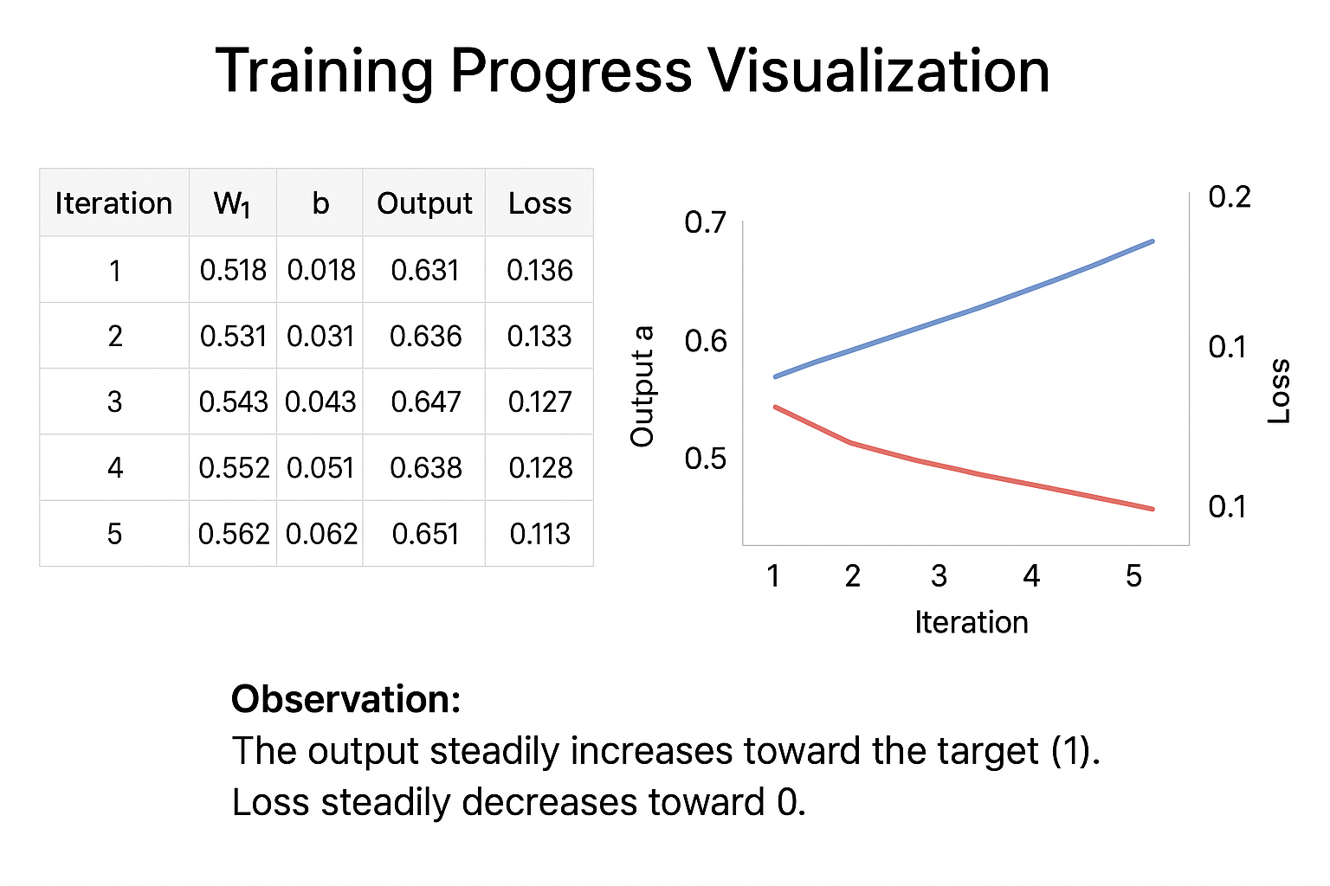

Slide 31
XOR-Python
Train a 2-2-1 neural network (2 inputs, 2 hidden neurons, 1 output) to learn the XOR function using numeric examples and backpropagation in Python using numpy
Sigmoid activation function used for hidden and output layers
Backpropagation updates weights and biases
Training over 10,000 epochs reduces the loss, learning XOR mapping

Slide 32
import numpy as np
# XOR Input and Output
X = np.array([[0, 0],
[0, 1],
[1, 0],
[1, 1]])
y = np.array([[0], [1], [1], [0]])
# Sigmoid activation function
def sigmoid(x):
return 1 / (1 + np.exp(-x))
def sigmoid_derivative(x):
return x * (1 - x)

Slide 33
# Initialize weights randomly
np.random.seed(42)
input_layer_neurons = 2
hidden_layer_neurons = 2
output_neurons = 1
# Weight matrices
wh = np.random.uniform(size=(input_layer_neurons, hidden_layer_neurons))
bh = np.random.uniform(size=(1, hidden_layer_neurons))
wout = np.random.uniform(size=(hidden_layer_neurons, output_neurons))
bout = np.random.uniform(size=(1, output_neurons))
# Training parameters
lr = 0.1
epochs = 10000
Notes:
# Training loop
for epoch in range(epochs):
# Forward Propagation
hidden_input = np.dot(X, wh) + bh
hidden_output = sigmoid(hidden_input)
final_input = np.dot(hidden_output, wout) + bout
final_output = sigmoid(final_input)
# Calculate error
error = y - final_output
# Backpropagation
d_output = error * sigmoid_derivative(final_output)
error_hidden = d_output.dot(wout.T)
d_hidden = error_hidden * sigmoid_derivative(hidden_output)

Slide 34
# Training loop
for epoch in range(epochs):
# Forward Propagation
compute
hidden_input
hidden_output
Final_output
# Calculate error

Slide 35
# Backpropagation
d_output =?
error_hidden =
d_hidden =

Slide 36
# Backpropagation
d_output =?
error_hidden =
d_hidden =
# Update weights and biases
wout += hidden_output.T.dot(d_output) * lr
bout += np.sum(d_output, axis=0, keepdims=True) * lr
wh += X.T.dot(d_hidden) * lr
bh += np.sum(d_hidden, axis=0, keepdims=True) * lr
# Print loss every 1000 epochs
if epoch % 1000 == 0:
loss = np.mean(np.square(error))
print(f"Epoch {epoch}, Loss: {loss:.4f}")
# Final output
print("\nTrained output:")
print(final_output)

Slide 37
plot the decision boundary
import matplotlib.pyplot as plt
# Create a meshgrid of points in input space
xx, yy = np.meshgrid(np.linspace(-0.5, 1.5, 200),
np.linspace(-0.5, 1.5, 200))
grid = np.c_[xx.ravel(), yy.ravel()]
# Forward pass for the grid points
hidden_grid = sigmoid(np.dot(grid, wh) + bh)
output_grid = sigmoid(np.dot(hidden_grid, wout) + bout)
output_grid = output_grid.reshape(xx.shape)
# Plot decision boundary
plt.contourf(xx, yy, output_grid, levels=[-0.1, 0.5, 1.1], colors=['lightcoral', 'lightgreen'], alpha=0.6)
plt.scatter(X[:, 0], X[:, 1], c=y.flatten(), s=200, edgecolors='k', cmap=plt.cm.coolwarm)
plt.title("XOR Neural Network Decision Boundary")
plt.xlabel("Input 1")
plt.ylabel("Input 2")
plt.show()

Slide 38
Conclusion
• Backpropagation is the core of neural network training.
• Uses gradients to adjust weights.
• Python + NumPy enables simple implementations.
• Frameworks (TensorFlow, PyTorch) extend this to large models.

